Slide 1



CAPSTONE 004D
MOTOWORK
Javier Bastias, Felipe González y Jose Pinchi

Slide 2

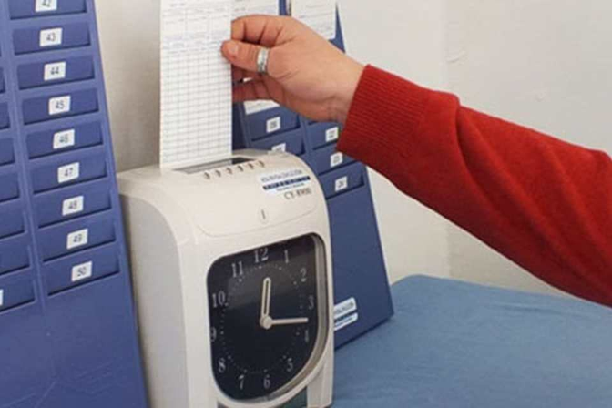



BEFORE WE START...
Disadvantages:
Obsolete Processes
Spends a lot of time
Impractical processes
Many times they do not give answers

Slide 3


PROBLEMATIC
Motorola Solutions needs improvements in:
Shift management
Employee Document Management
Request management (Vacation, licenses and permits)

Slide 4





SOLUTION
Create a mobile application that allows all of these processes to be done simply and quickly for Motorola staff.

Slide 5







TECHNOLOGIES USED
1
2
3
4
5
6
7
Authentication
Storage
Cloud Firestore

Slide 6
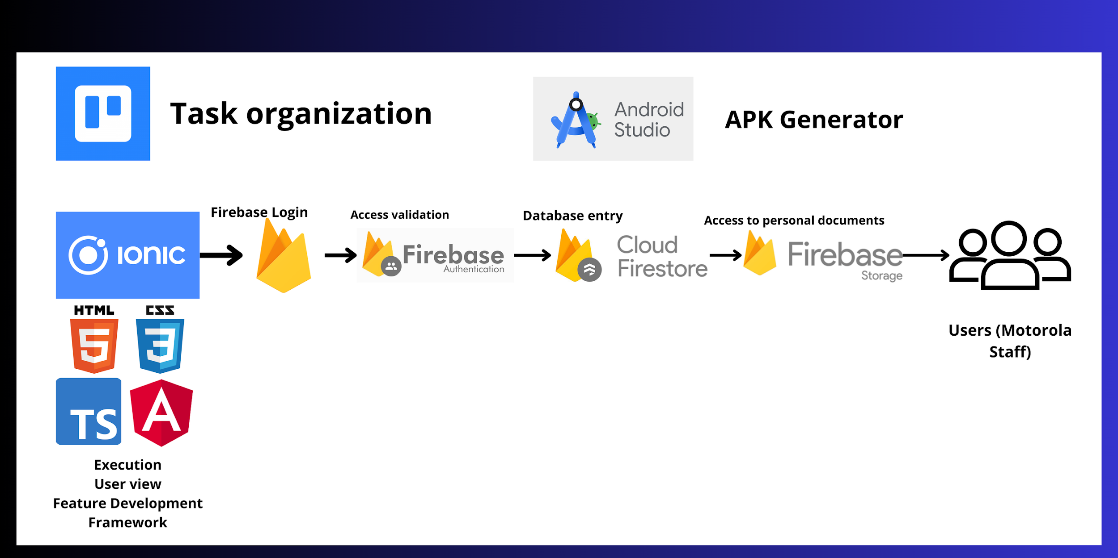
ARQUITECTURA DE LA APLICACION

Slide 7


USE CASE (VIDEO)

Slide 8

LET'S TRY THE APPLICATION!

Slide 9
CONCLUSION

